Slide 1

TOPIC: SMS SPAM DETECTION USING DECISION TREE Guided by:-SHIBDAS DUTTA

Slide 2
Presented by:-
SHREYA MALLICK
AKANSHA MISHRA
SUDIP RANJIT
SOUVIK DAS

Slide 3
CONTENT
1.OVERVIEW
2.GOAL
3.WHAT WE WILL BE DOING?
4.HOW THE DATA LOOKS LIKE?
5.DATA VISUALIZATION
6.PROPOSED MODEL
7.EVALUATION RESULT
8.CONCLUSION

Slide 4
OVERVIEW
In this presentation, we will explore the power of Decision Tree Classifier Algorithm in SMS Spam Detection. We will discuss its application, benefits, and effectiveness in identifying and filtering out spam messages.
SMS Spam Detection: Decision Trees in ML. Dataset collection, Decision Tree basics, feature selection, model training, evaluation metrics, and results. Emphasis on using Decision Trees for efficient SMS spam identification.

Slide 5
GOAL
● The model we built here will use all possible factors to predict which messages are spam or ham.
● Our goal is to discriminate amongst the SMS to be spam or ham.
●Our goal is to increase the Information Gain so as to get the highest accuracy.
●And our goal is to reduce the Entropy or the impurities of our dataset to get better prediction.

Slide 6
What will we be doing?
In this term project, we will try to analyze 5573 transactions with different attributes.
Itinerary:
Analyze the correlation between attributes.
Analyze the effect of attributes’ values on target
Feature Engineering
Application of the machine learning algorithms

Slide 7
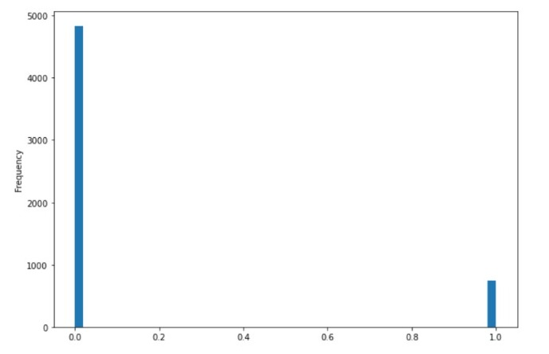
How the data looks like?
The original data has 5573 instances and 2 attributes
The Class attribute spam[1] or ham[0].
The distribution of data is as:

Slide 8
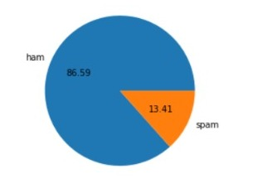
Data Visualization
In this step, we have tried to visualize in the data by finding
Cor-relation.
Target Value Impact.
Distribution of the attribute values.
Here, we have used Pyplot to diagrammatically display the two attributes those are Ham and Spam to showcase a plotting area and decorates the plot with labels.

Slide 9
Proposed Model
Decision Trees
In machine learning are hierarchical structures that split data based on features, aiding in classification or regression. They work by selecting the most informative attributes to create branches, forming a tree-like model. Nodes represent features, while edges denote decisions or outcomes. They're intuitive, allowing interpretability due to their visual nature.. However, they may Overfit without proper pruning or struggle with complex relationships. Despite limitations, their simplicity and interpretability make them valuable for various applications, offering insights into decision-making processes within the model.

Slide 10
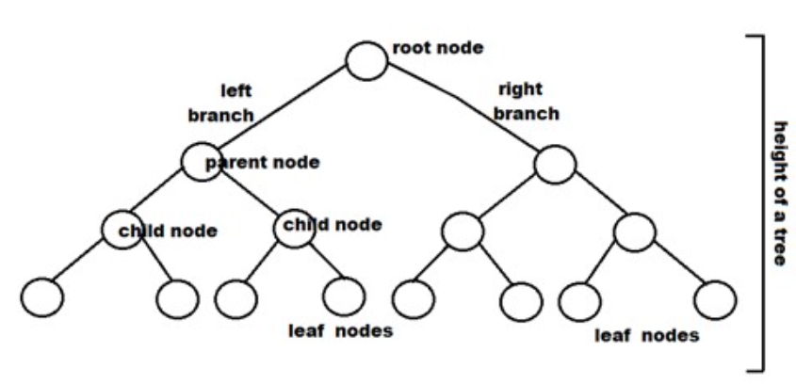
What is a root node?
A node that is the first or topmost node in a tree is called a root node. In every tree, there is always one root node, which is the only node that has never previously been connected to another node.
What is a leaf node?
A node that does not have any child node is called a leaf node.
internal node
An intermediate node between the root and the leaf nodes is called an internal node

Slide 11
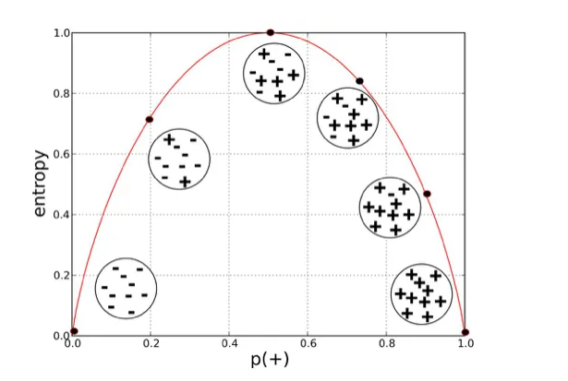

Entropy and gini index
What is Entropy?
Entropy is nothing but the measure of disorder. (You can think of it as a measure of purity as well.
The Mathematical formula for Entropy is as follows -
What do you mean by information gain?
Information gain is the reduction in entropy or surprise by transforming a dataset and is calculated by comparing the entropy of the dataset before and after a transformation.
Information Gain = 1 ∞ 1/Entrophy

Slide 12


Gini Index
The lower the Gini Index, the better the lower the likelihood of misclassification.
The formula for Gini Index
The Gini Index has a minimum (highest level of purity) of 0. It has a maximum value of .5. If Gini Index is .5, it indicates a random assignment of classes.
Information Gain ∞ Gini Index
Gini Index ∞ 1/Entrophy

Slide 13
Evaluation Result
The term "accuracy" is used in various contexts, but in general, it refers to the degree of correctness or precision of something. Here are a few common definitions in different domains:
In the context of classification algorithms, accuracy is a measure of the correctness of predictions made by a model. It is calculated as the ratio of correctly predicted instances to the total number of instances. The formula for accuracy is:
Accuracy=Number of Correct Predictions Total Number of Predictions×100Accuracy=Total Number of Predictions Number of Correct Predictions​×100
In our project we got the accuracy by using Gini Index Value as 97.20 and Entropy Value as 96.76.

Slide 14
Conclusion
We investigated the data, checking for data unbalancing, visualizing the features and understanding the relationship between different features
We used both train-validation split and grid-search cv to evaluate the model effectiveness to predict the target value.
We then investigated five predictive models:
We started with Logistic Regression, Decision Tree , Gaussian Naïve Bayes , K- nearest neighbors(KNN), accuracy is almost same.
We choose based model based on minimum value of True Negative value and maximum true positive

